Slide 1



The F# Path to Relaxation
Language Design, Platforms, Community, Openness
Don Syme, F# Community Contributor, MSR Principal Researcher in Mobile Tools

Slide 2
A Gentle Stroll Through the Land of Language Design and Delivery

Slide 3
A starting position…. The great disputes of computer science should be struggled with They are chances to make a better, simpler, more relaxed world

Slide 4
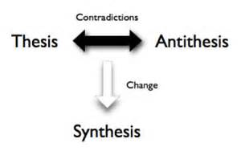
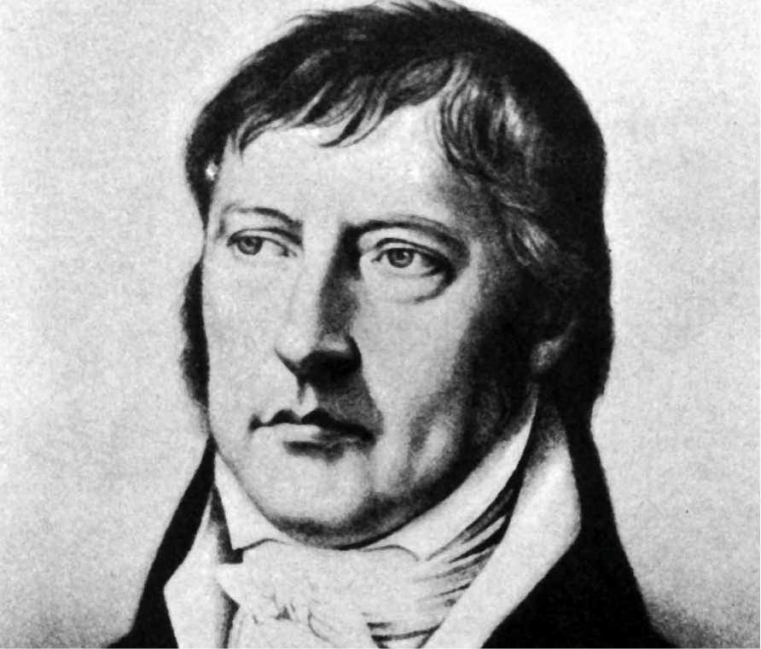
Not a new idea…

Slide 5
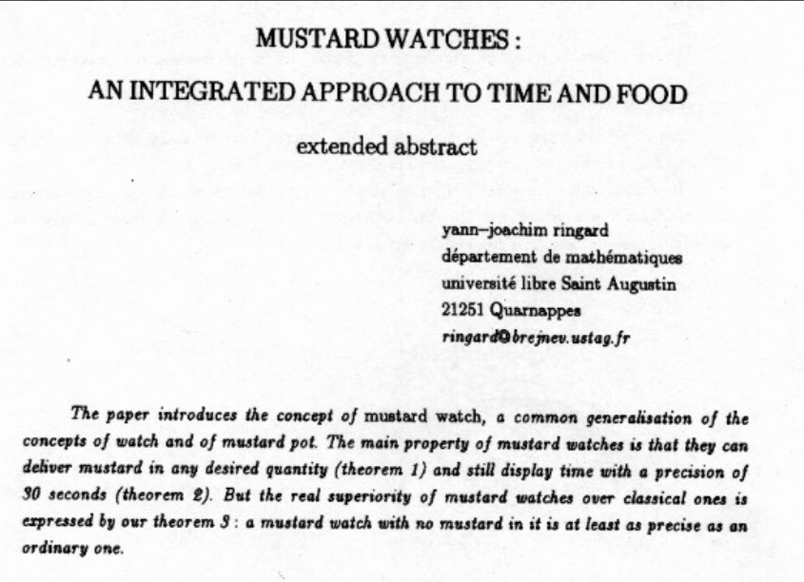
You can of course take this too far :)

Slide 6
X
Y
?

Slide 7
Functional
Interop

Slide 8
Then (2003) Functional languages were isolated, non-interoperable, using their own VMs. Interop standards like C-calls, COM, CORBA, XML were a mess for language-integration.

Slide 9
The F# Approach (also Scala, Swift, …) Embrace industry-standard runtime layers, and influence them. Keep exosystem at an appropriate distance. Design with end-to-end interop in mind. Compromise where needed.

Slide 10
Relaxation Achieved, 200% ✔ ✔ Today’s FP languages are immensely interoperable while staying true to FP principles. ✔ F# type providers raise interop to a completely new level ✖ Some tensions remain – not all functional techniques are easily implemented on industry standard VMs
Functional
Interop

Slide 11
X
Y
?

Slide 12
Enterprise
Openness

Slide 13
TL;DR – Where we are now
F# is open, cross-platform, neutral, independent
The F# Compiler Service powers many other tools
F# 4.5 now complete!
Debian, RPM and .NET Core for Linux/OSX
All F# language and tooling is accepting contributions
Fable for F#-to-Javascript
SAFE for F# fullstack
The F# community is very “self-empowered”
fsharp.org
Visual Studio for Windows, Azure, Mac
Xamarin provide F# tools Android and iOS

Slide 14
F# shifted to open engineering in 2014 .NET Core shifted to open engineering in 2016 In three years, we’ve come a long way!

Slide 15
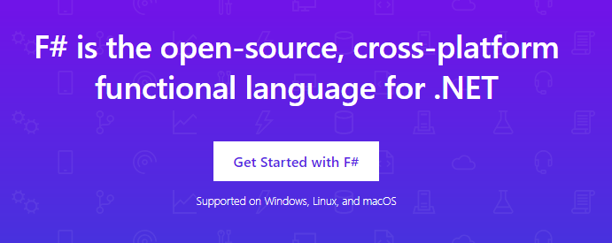
www.microsoft.com/net/

Slide 16
The F# Compiler – 500+ Pull Requests and rising Where to Contribute? See fsharp.github.io

Slide 17
The F# Language Design Process github.com/fsharp/fslang-design github.com/fsharp/fslang-suggestions

Slide 18
F# 4.0 ✔ True shift to cross-platform open engineering ✔ Laundry list of language items ✔ Normalized core library ✔ Type providers more powerful ✔ Better debugging, tooling, performance ✔ ~20% compiler perf improvement
https://github.com/fsharp/fslang-design/tree/master/FSharp-4.0

Slide 19
F# 4.1 ✔ Optional large scope cycles more on this later) ✔ Result<T,Error> in standard library ✔ Unboxed (struct) tuples ✔ Unboxed (struct) records ✔ Unboxed (struct) unions ✔ Morebits and pieces
https://github.com/fsharp/fslang-design/tree/master/FSharp-4.1

Slide 20
F# 4.5 ✔ Span<T> high perf type-safe non-allocating code ✔ Improved async debugging ✔ More bits and pieces
https://github.com/fsharp/fslang-design/tree/master/FSharp-4.5

Slide 21
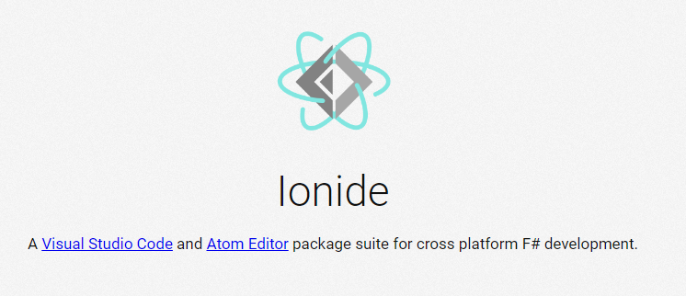
VSCode/Atom + Ionide = Cross-Platform F# Editing Love

Slide 22
F# and .NET Core (Linux, OSX, Windows) dotnet new -lang F# dotnet build docs.microsoft.com/dotnet/core/

Slide 23

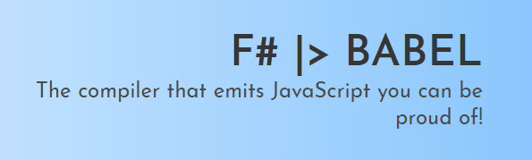
Fable! fable.io

Slide 24
The F# Compiler Service fsharp.github.io/FSharp.Compiler.Service

Slide 25
Relaxation Achieved ✔ Enterprise Quality + Openness + Community + Tooling + Ecosystem + Evolution Path = Goodness
Enterprise
Openness

Slide 26
X
Y
?

Slide 27
Functional
Objects

Slide 28
Then (2003) In the 1990s functional languages were historically anti-OO Even today any mention of objects gives some people an “urrgghhh…” reaction. Modern Compiler Implementation with Standard ML - Chapter 14, Object Oriented Programming object – to express a dislike or distaste for something

Slide 29
F# - Objects + Functional
type Vector2D (dx:double, dy:double) =
let d2 = dx*dx+dy*dy
member v.DX = dx
member v.DY = dy
member v.Length = sqrt d2
member v.Scale(k) = Vector2D (dx*k, dy*k)
Inputs to object
construction
Object internals
Exported properties
Exported method

Slide 30
Objects
Constructed Class Types
type ObjectType(args) =
let internalValue = expr
let internalFunction args = expr
let mutable internalState = expr
member x.Prop1 = expr
member x.Meth2 args = expr
Object Expressions
{ new IObject with
member x.Prop1 = expr
member x.Meth1 args = expr }
{ new Object() with
member x.Prop1 = expr
interface IObject with
member x.Meth1 args = expr
interface IWidget with
member x.Meth1 args = expr }
Object Interface Types
type IObject =
interface ISimpleObject
abstract Prop1 : type
abstract Meth2 : type -> type

Slide 31
The F# approach is to embrace objects, make them fit with the expression-oriented typed functional paradigm especially for interop and software engineering purposes but not embrace full “object-orientation”

Slide 32
Object Programming focuses on … succinct coding, notational convenience API ergonomics good naming practical encapsulation sensible, small, composable abstractions expression-oriented making simple things out of (potentially complex) foundations

Slide 33
Object-Oriented Programming too often means… objects as a single paradigm overuse of hierarchical classification (Animal, Cat, Dog, AbstractJellyBeanFactoryDelegator) large abstractions with many holes and failure points declarations not expressions complex things by inheriting from complex things…

Slide 34
The F# approach is to embrace object programming, make it fit with the expression-oriented typed functional paradigm but not embrace full “object-orientation” (unless you happen to be in a project using that technique)

Slide 35
Positive Synthesis Achieved ✔ some limitations remain… and there is one area in particular that’s worth discussing….
Functional
Objects

Slide 36
A functional-first approach makes a huge difference in practice fsharp.org/testimonials

Slide 37
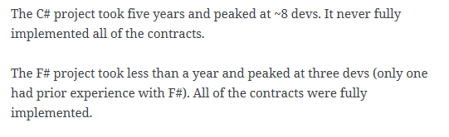
An analysis (Simon Cousins, Energy Sector)
350,000
lines of C# OO
by offshore team
30,000
lines of robust F#, with
parallel +more features
An application to evaluate the revenue due from Balancing Services contracts in the UK energy industry
http://simontcousins.azurewebsites.net/does-the-language-you-use-make-a-difference-revisited/

Slide 38
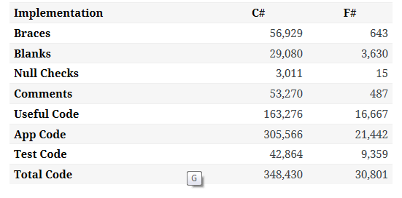

Slide 39
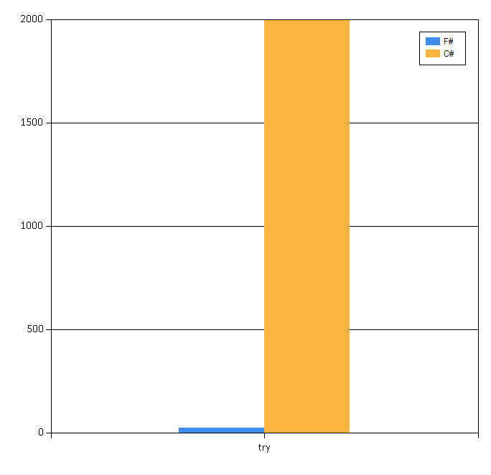

Slide 40
Simon Cousins, Energy Sector
Zero
bugs in deployed system
“F# is the safe choice for this project,
any other choice is too risky”
An application to evaluate the revenue due from Balancing Services contracts in the UK energy industry
http://simontcousins.azurewebsites.net/does-the-language-you-use-make-a-difference-revisited/

Slide 41
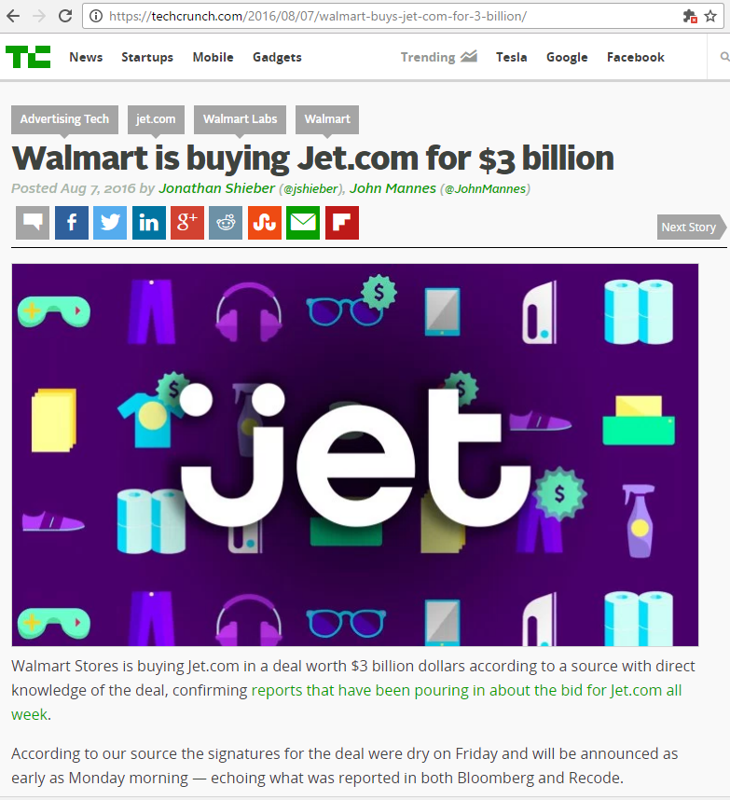
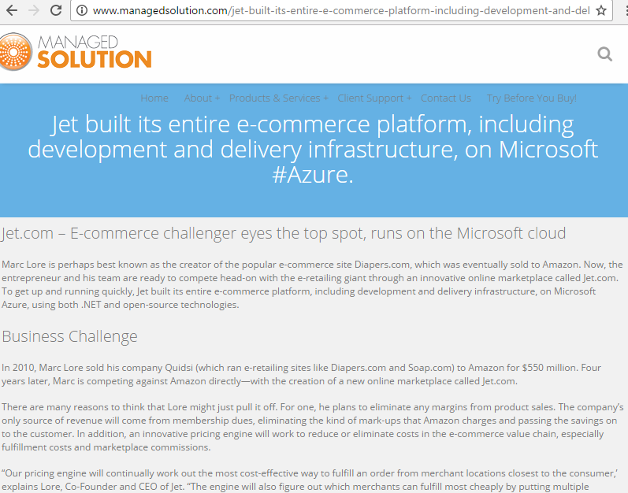
A $3B Unicorn, Built on F#

Slide 42
X
Y
?

Slide 43
Code
Data
In one large company, ~500 people work on tooling for this
…and 5000+ people work on tooling for this

Slide 44
We are living through an information revolution

Slide 45
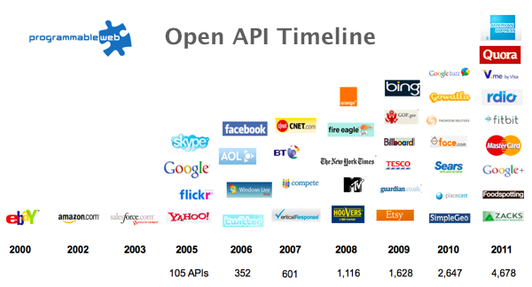
The Information Revolution
2012
2013
6,432
10,537

Slide 46
We need to bring information into the language… At internet-scale, strongly tooled, strongly typed

Slide 47
Paradigm Locator
Statically Typed
Dynamically Typed
Options
make statically typed langs more dynamic
make dynamically typed langs more static
apply moderated static typing much more broadly

Slide 48
Enter F# Type Providers…. “Just like a library” “A design-time component that computes a space of types and methods on-demand…” “An adaptor between data/services and the .NET type system…” “On-demand, scalable compile-time provision of type/module definitions…”

Slide 49
http://fsharp.github.io/FSharp.Data/images/csv.gif http://fsharp.github.io/FSharp.Data/images/wb.gif

Slide 50
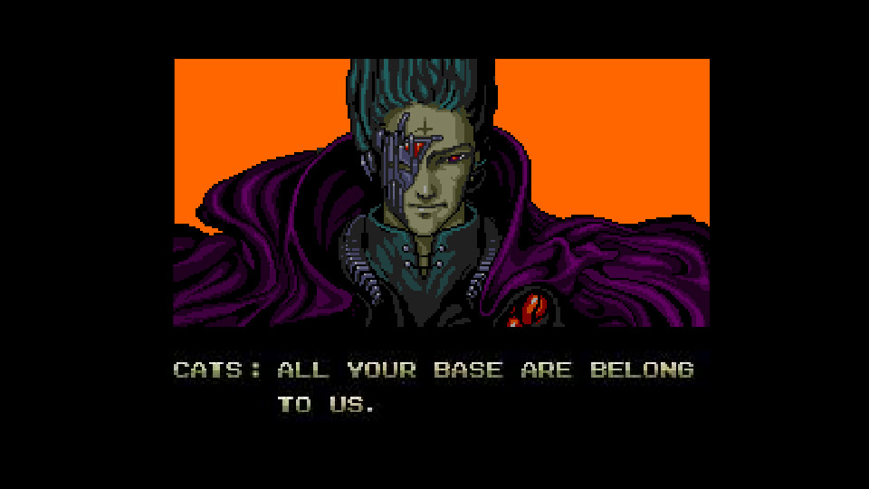
Theme #1 - Many Data Sources, One Mechanism
Segoe UI Light
types

Slide 51
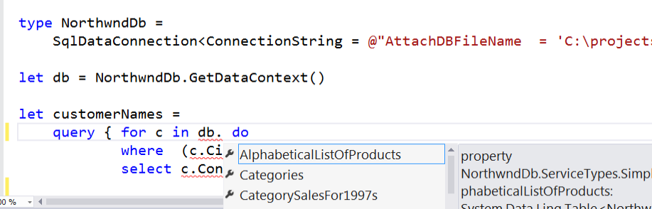
SQL #1

Slide 52
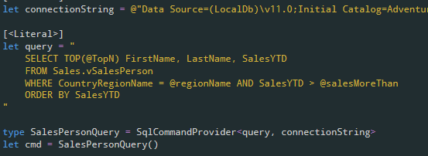
SQL #2

Slide 53
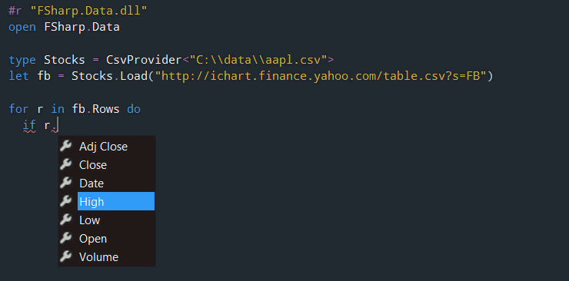
CSV

Slide 54
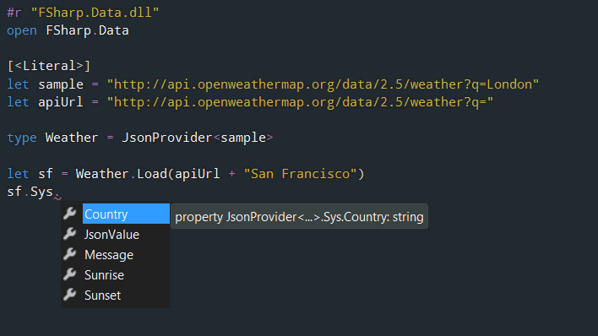
JSON

Slide 55
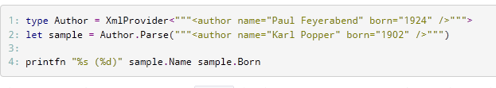
XML

Slide 56
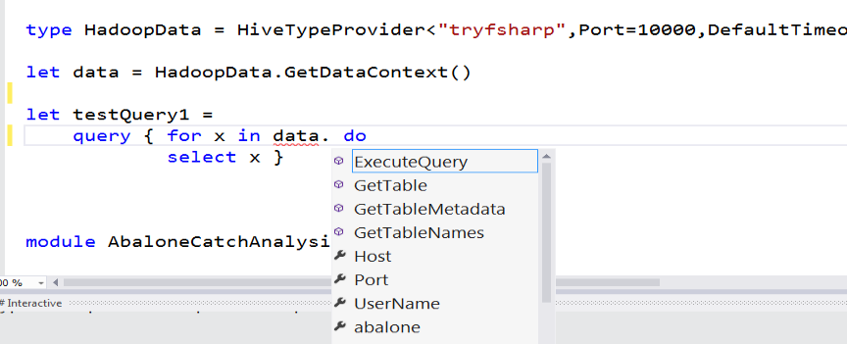
Hadoop/Hive

Slide 57
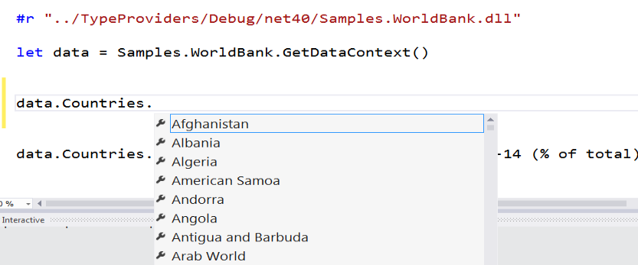
Web APIs

Slide 58
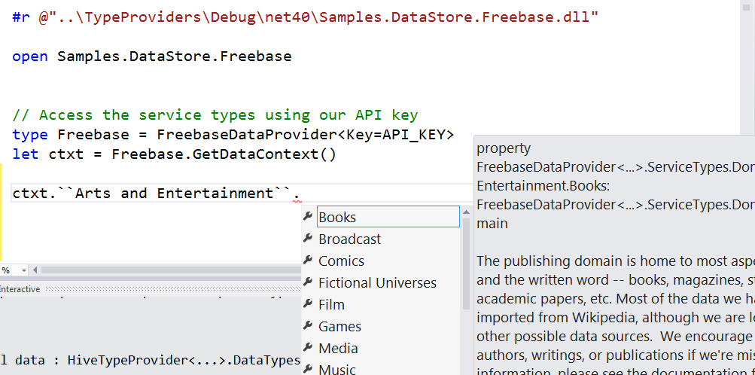
Entity Graphs

Slide 59
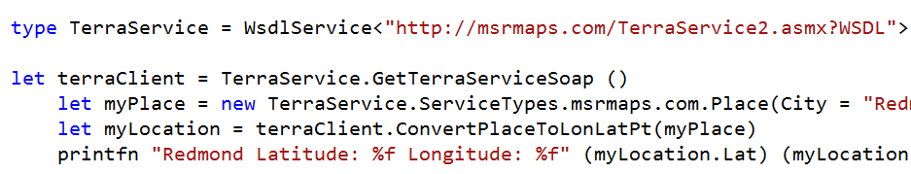
WSDL

Slide 60
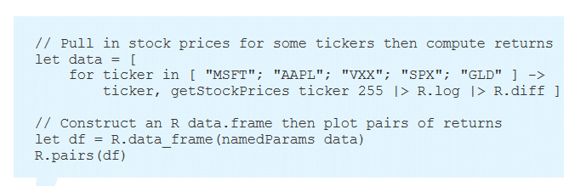
R

Slide 61
“The idea of integrating internet-scale information services directly into the program's variable and type space is probably the most innovative programming language idea I’ve heard of in a decade” (Jim Cordy, Queens U) Overly kind, but thought provoking!

Slide 62
Relaxation Achieved ✔ ✔ F# Type Providers have been a hugely successful feature – their range of useful application is enormous. They bring data and typed programming into synthesis like no other feature around
Code
Data

Slide 63
X
Y
?

Slide 64
Sync
Async

Slide 65
Pattern Matching
Abstraction

Slide 66
Numbers
Numbers-with Units

Slide 67
http://fsharp.org/use/gpu ✔
GPU
CPU
Alea GPU

Slide 68
In Conclusion – Remember the Hegel!

Slide 69
Functional
Objects
Sync
Async
Code
Data
Open
Enterprise
…
…
Opposites come in all shapes and flavours
Achieve relaxation today ☺
Synthesis from contradiction is at the heart of applied PL design

Slide 70
Thank you!! Questions?

Slide 71
F# programmers love… Code that is succinct Code that is expressive Code that interoperates Code that is performant Code that is accurate Code that is well-tooled

Slide 72
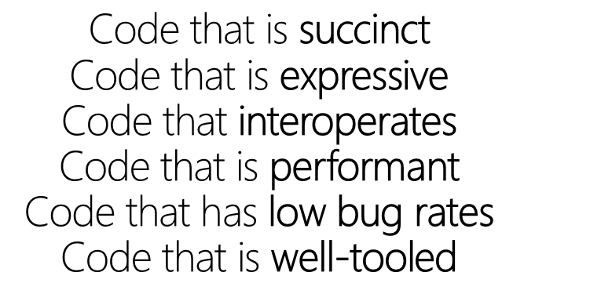
Code we love!
printfn "hello world"
✓
✓
✓
✓
✓
✓

Slide 73
Code we love! - pipelines
x |> f1
x |> f1 |> f2 |> f3 |> …..

Slide 74
Code we love! - pipelines
let symbolUses =
symbolUses
|> Array.filter (fun symbolUse -> …)
|> Array.Parallel.map (fun symbolUse -> …)
|> Array.filter (fun … -> …)
|> Array.groupBy (fun … -> …)
|> Array.map (fun … ->….)

Slide 75
Code we love! - pipelines - domain modelling

Slide 76
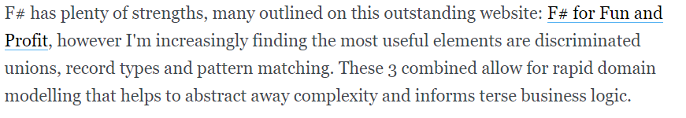
Code we love :) - pipelines - domain modelling
type Status =
| Online
| Unresponsive of string
| Missing of string
| NotChecked of string
| Ignored
https://lukemerrett.com/fsharp-domain-modelling/

Slide 77

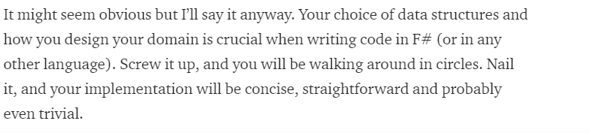
Code we love :) - pipelines - domain modelling
type Value =
| Integer of int64
| String of string
| Date of DateTime
| Data of string
| Bool of bool
| Dict of (string * Value) list
| Array of Value list
https://medium.com/@odytrice Ody Mbegbu

Slide 78
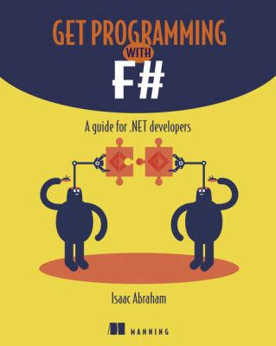
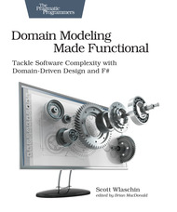
Code we love :) - pipelines - domain modelling - domain semantics

Slide 79
Code we love :) - reactive, functional UIs

Slide 80
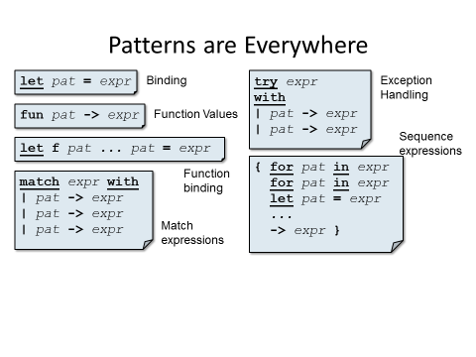
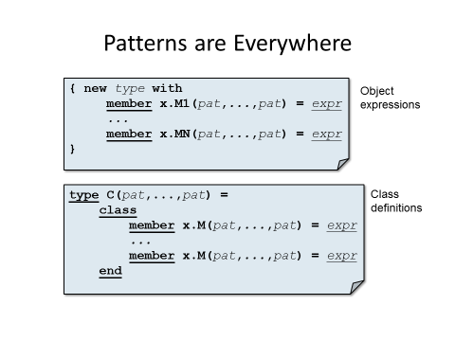

Slide 81
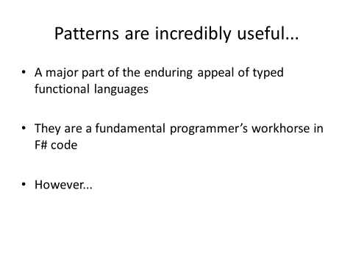
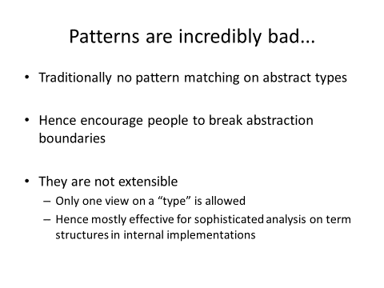

Slide 82
Enter F# Active Patterns…. (Similar to Scala extractors, designed at the same time in loose cooperation)

Slide 83
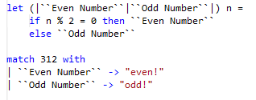

Slide 84
module BasicPatterns =
let (|Value|_|) (e:FSharpExpr) = ...
let (|Const|_|) (e:FSharpExpr) = ...
let (|TypeLambda|_|) (e:FSharpExpr) = ...
let (|Lambda|_|) (e:FSharpExpr) = ...
let (|Application|_|) (e:FSharpExpr) = ...
let (|IfThenElse|_|) (e:FSharpExpr) = ...
let (|Let|_|) (e:FSharpExpr) = ...
let (|LetRec|_|) (e:FSharpExpr) = ...
let (|NewRecord|_|) (e:FSharpExpr) = ...
let (|NewUnionCase|_|) (e:FSharpExpr) = ...
let (|NewTuple|_|) (e:FSharpExpr) = ...
let (|TupleGet|_|) (e:FSharpExpr) = ...

Slide 85
let (|IdentifierNameSyntax|_|) (n: CSharpSyntaxNode) =
match n with
| :? IdentifierNameSyntax as t -> Some(t.CSharpKind(), t.Identifier)
| _ -> None
let (|IdentifierName|_|) (n: CSharpSyntaxNode) =
match n.CSharpKind() with
| SyntaxKind.IdentifierName -> ...
| _ -> None
let (|QualifiedNameSyntax|_|) (n: CSharpSyntaxNode) =
match n with
| :? QualifiedNameSyntax as t -> ...
| _ -> None
let (|QualifiedName|_|) (n: CSharpSyntaxNode) =
match n.CSharpKind() with
| SyntaxKind.QualifiedName -> ...
| _ -> None

Slide 86
Relaxation Achieved ✔ An extremely useful mechanism that greatly expands the utility of pattern matching in the language while allowing abstraction Don’t leave home without them!
Pattern Matching
Abstraction

Slide 87
Code we love :) - reactive, functional UIs - view functions!
A functional-reactive dynamic web view
/// The view function giving updated content for the page
let view model dispatch =
match model.Text with
| [| |] ->
div [] [ div [] [str "Loading..."] ]
| _ ->
div [ ClassName "container" ] [
button [ OnClick (fun _ -> dispatch Faster) ] [ str "Faster" ]
div [ ClassName "theText" ] [ str model.Text.[model.Index] ]
button [ OnClick (fun _ -> dispatch Slower) ] [ str "Slower" ]
div [] [ str (sprintf "Ticks Per Update: %d" model.TicksPerUpdate) ]
]

Slide 88
Code we love :) - reactive, functional UIs - view functions!
A functional-reactive mobile app view
/// The view function giving updated content for the page
let view (model: Model) dispatch =
if model.Pressed then
Xaml.Label(text="I was pressed!")
else
Xaml.Button(text="Press Me!", command=(fun () -> dispatch Pressed))

Slide 89
Code we love :) - an app in a file!
A full Xamarin mobile app
type Msg = | Pressed
type Model = { Pressed: bool }
let init() = { Pressed=false }
let update msg model =
match msg with
| Pressed -> { model with Pressed = true }
let view (model: Model) dispatch =
if model.Pressed then
Xaml.abel(text="I was pressed!")
else
Xaml.Button(text="Press Me!", command=(fun () -> dispatch Pressed))
type App () =
inherit Application ()
do Program.run init update view
The messages
The model
The initial model
The update function
The dynamic view
Host+run
github.com/fsprojects/Elmish.XamarinForms/

Slide 90

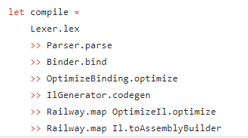
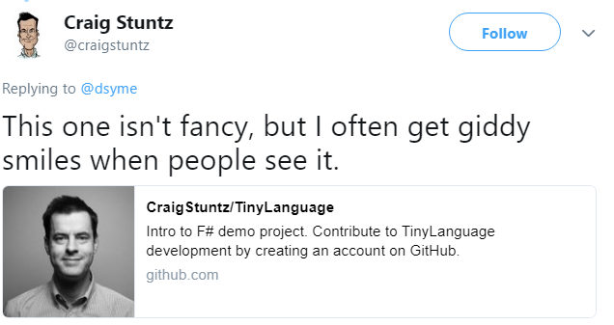
Code we love :) - composition

Slide 91
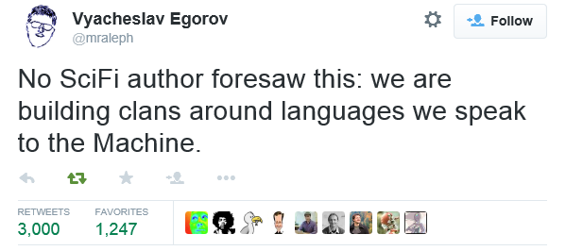
In Conclusion – Some Observations
“Language culture matters more than language features”
But if it’s so important, who studies it?

Slide 92
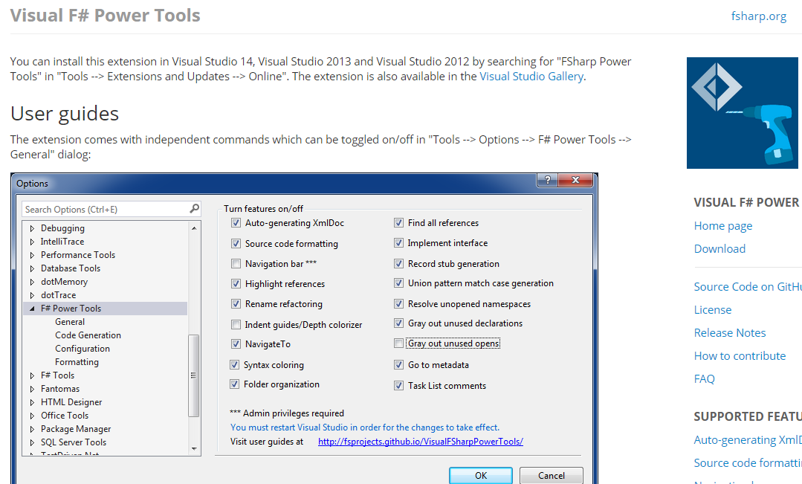

Slide 93
Data is like water…
Everyone needs it. Everyone knows where to get it.
Nobody is sure where it really came from, or goes to.
…really knows its true cost, or true value.
…likes to pay for it, or to share it.
…knows how much is wasted.
You might get washed away by it.
You only find out it was bad after you have drunk it.

Slide 94
Total Recognizers
Multiple tags
= View
= Total Recognizer
let rec toString (typ:System.Type) =
if typ.IsGenericType then
let con = typ.GetGenericTypeDefinition()
let args = typ.GetGenericArguments()
"(" + con.Name + " ...)"
elif not typ.HasElementType then
"(" + typ.Name + ")"
elif typ.IsArray then
let arg = typ.GetElementType()
let rank = typ.GetArrayRank()
"(Array " + " " + toString arg + ")"
elif typ.IsByRef then
let arg = typ.GetElementType()
"(ByRef " + " " + toString arg + ")"
elif typ.IsPointer then
let arg = typ.GetElementType()
"(Ptr " + " " + toString arg + ")"
elif typ.IsGenericParameter then
let pos = typ.GenericParameterPosition
let cxs = typ.GetGenericParameterConstraints()
"Param ..."
else failwith "Docs says this can't happen"
let (|Named|Array|ByRef|Ptr|Param|) (typ : System.Type) =
if typ.IsGenericType then Named(typ.GetGenericTypeDefinition(),
typ.GetGenericArguments())
elif not typ.HasElementType then Named(typ, [| |])
elif typ.IsArray then Array(typ.GetElementType(),
typ.GetArrayRank())
elif typ.IsByRef then ByRef(typ.GetElementType())
elif typ.IsPointer then Ptr(typ.GetElementType())
elif typ.IsGenericParameter then Param(typ.GenericParameterPosition,
typ.GetGenericParameterConstraints())
else failwith “Docs says this can't happen"
type System.Type ≈
| Named of System.Type * System.Type[]
| Array of System.Type * int // rank
| ByRef of System.Type
| Ptr of System.Type
| GenericParam of int * System.Type[] // constraints
Typical code to analyze and traverse a System.Type value
Tags can be used on RHS
This type is in the .NET Library
This code extracts the essence of the decomposition
let rec toString typ =
match typ with
| Named (con, args) -> "(" + con.Name + " ...)"
| Array (arg, rank) -> "(Array " + " " + toString arg + ")"
| ByRef arg -> "(ByRef " + toString arg + ")"
| Ptr arg -> "(Ptr " + toString arg + ")"
| Param(pos,cxs) -> "Param"
In this case we maintain completeness and redundancy checking

Slide 95
Active Patterns in F#
These tags are “active recognizer labels”
The whole function is an “active recognizer”.
Two views on complex numbers
let (|Rect|) (x:complex) = (x.Real, x.Imaginary)
let (|Polar|) (x:complex) = (x.Magnitude , x.Phase)
They are just ordinary functions with “banana names”
let mulViaPolar c1 c2 =
match c1,c2 with
| Polar(r1,th1),Polar(r2,th2) ->
CreatePolar(r1*r2, th1+th2)
let mulViaRect (Rect(ar,ai)) (Rect(br,bi)) =
CreateRect(ar*br - ai*bi, ai*br + bi*ar)
let mulViaPolar (Polar(r1,th1)) (Polar(r2,th2)) =
CreatePolar(r1*r2, th1+th2)
let mulViaRect c1 c2 =
match c1,c2 with
| Rect(ar,ai), Rect(br,bi) ->
CreateRect(ar*br - ai*bi, ai*br + bi*ar)
The use of active recognizer labels implicitly select and apply the function
(|Rect|)
(|Polar|)

Slide 96
Total Recognizers
let rec toString typ =
match typ with
| Named (con, args) -> "(" + con.Name + " ...)"
| Array (arg, rank) -> "(Array " + " " + toString arg + ")"
| ByRef arg -> "(ByRef " + toString arg + ")"
| Ptr arg -> "(Ptr " + toString arg + ")"
| Param(pos,cxs) -> "Param"
(|Named|Array|ByRef|Ptr|Param|)

Slide 97
Theme #3 Type Systems Encounter Reality

Slide 98
This is different…
“The idea of integrating internet-scale information services directly into the program's variable and type space is probably the most innovative programming language idea I’ve heard of in a decade” (Jim Cordy, Queens U)
Perhaps, perhaps not…
But if something so simple is perceived as so different, we need think why
(What follows is somewhat whimsical)

Slide 99
This is different…
We like to see PL systems as logical systems
Traditional logical systems exclude interaction with reality
This is a powerful and simplifying assumption
It is also fundamentally wrong for modern applied programming languages

Slide 100


Γ $⊢ e$ : τ
Lots of work here
Lots of work here
The exclusion of reality!
The neglected child
Γ₀ = 0

Slide 101
Meditations on Γ₀
Γ₀ is the ever-growing ocean of digital reality around us
Γ₀ is big. Really big.
Γ₀ defies imagination for its enormity
Γ₀ is other. It doesn’t speak your language
Γ₀ is being organized at an incredible rate
Γ₀ needs help. It’s a mess.
Γ₀ is surprisingly “human”

Slide 102
Meditations on Γ₀
Γ₀ is full of uncertainty and probabilities.
You are mutually recursive with Γ₀. You are part of it.
Γ₀ has open doors, locked doors
Γ₀ has many, many parts that do not get on particularly well.
Γ₀ is so real you want to touch it, explore it
Don’t look too long.
It’s like staring at infinity

Slide 103
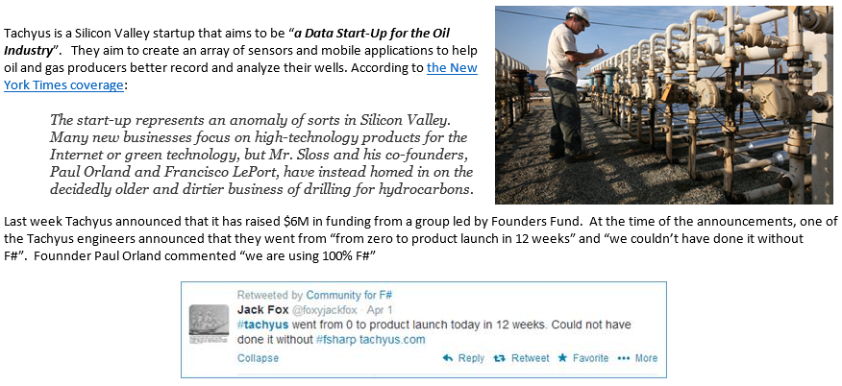
Startups
Correctness
Time to Market

Slide 104

Data is like water…

Slide 105

Actually these days it’s more like a flood…

Slide 106
Functional
 | Expression-oriented | No null | Multiple Args = Tuples | Closure and Capture | First-class Values | Currying | HM Type Inference
void (unit) | ✓ | ✓ | ✓ | ✓ | ✓ | ✓ | ✓
Object Types | ✓ | ✓ | ✓ | ✓ | ✓ | ✓ | ✓
Subtyping | ✓ | ✓ | ✓ | ✓ | ✓ | ✓ | ✓
Dot-notation | ✓ | ✓ | ✓ | ✓ | ✓ | ✓ | ¾
Inheritance | ✓ | ✓ | ✓ | ✓ | ✓ | ✓ | ¾
Method Overloding | ✓ | ✓ | ✓ | ✓ | ¾ | ✗ | ¾
Objects
Relatively Graceful Degradation
(some type annotations needed)
Relatively Graceful Degradation
(some type annotations needed)
Some combinations outlawed for sanity

Slide 107
Theme #2 - Data at Multiple Scales
From Everything to Individuals
Data Scripters need to work with different granularities of schematization
data.AllEntites
data.Automotive.``Automobile Models``
data.Automotive.``Automobile Models``.Individuals.``Porsche 911``
…Only a language that supports massively scalable metadata can operate at all these levels
Every stable entity can get a unique type

Slide 108
Circularities and Modularity in the Wild (Analysis by Scott Wlaschin and F# Community)

Slide 109
Mixed OO/Functional Programming Has Won Lambdas in C#, Java, C++, … Async monadic modality in C#, Javascript, PHP (Hack), … Function types in C#, TypeScript, … Generics in C#, Java, Visual Basic, … …

Slide 110
… except where it hasn’t Inheritance everywhere!!! Nulls everywhere!!! Circularities everywhere!!!!

Slide 111
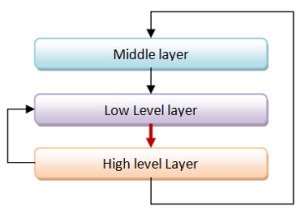
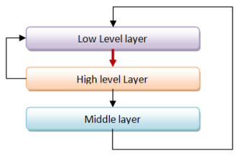
Unnecessary Circularities are Evil
To the functional programmer, it is “obvious” that our software methodology should help minimize and reduce cyclic dependencies in program structure.

Slide 112
The C# approach to circularity
All files in an “assembly” are mutually referential
Arbitrary circularity between “internal” items in an assembly
Mutually recursive “assemblies” are possible if you try hard

Slide 113
The F# approach to circularity
Like Haskell and OCaml, F# has a file ordering
F# encourages minimizing dependencies within a file
Parameterization the preferred technique
F# objects support limited forms of circularity when needed

Slide 114
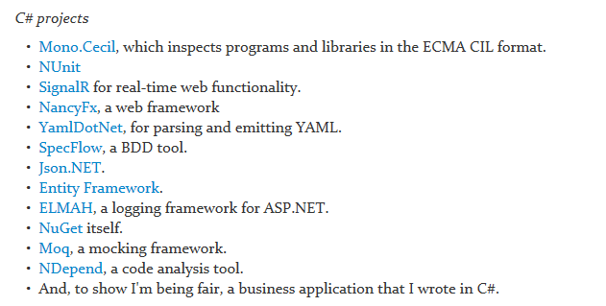
Let’s analyse some C# and F# projects

Slide 115
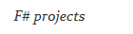
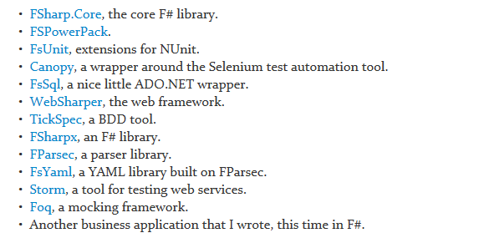
Let’s analyse some C# and F# projects

Slide 116
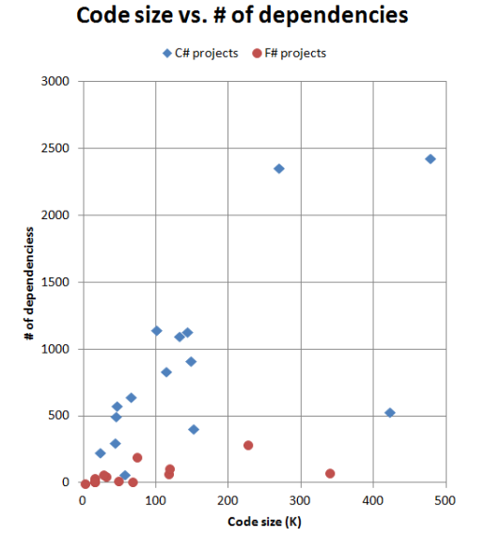
F# code has fewer top-level dependencies

Slide 117
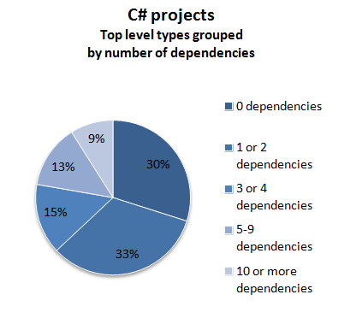
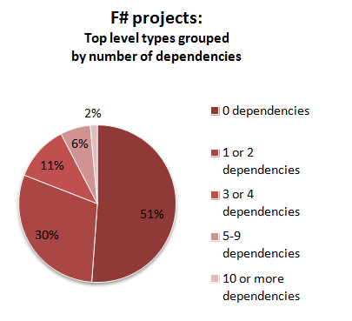

Slide 118
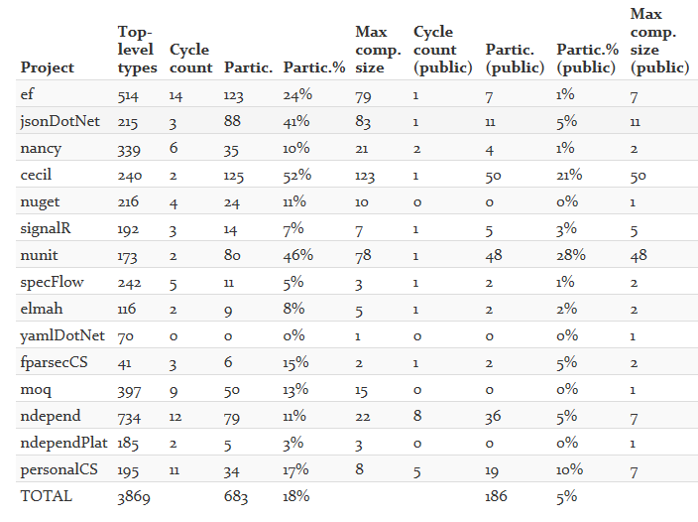

Slide 119
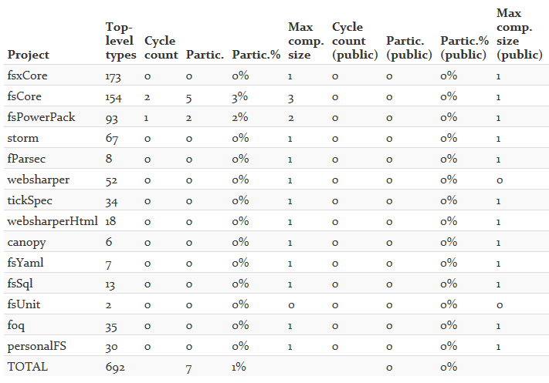

Slide 120
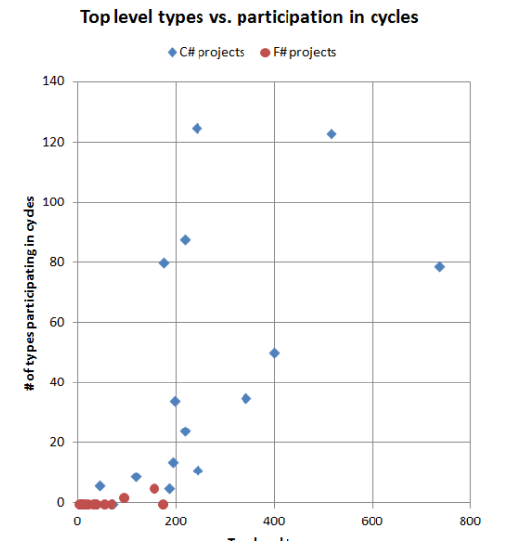
Why the difference between C# and F#?
In C#, there is nothing stopping you from creating cycles. In fact, you have to make a special effort to avoid them.
In F#, you can't easily create cycles at all.

Slide 121
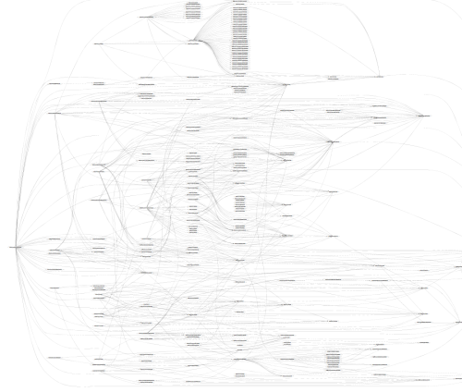
SpecFlow (C#)

Slide 122

TickFlow (F#)

Slide 123

Microsoft Entity Framework
TickFlow

Slide 124
In theory and in practice, unmoderated intra-component cycles are a disaster Language mechanisms that enforce acyclicity are “good” F# assumes cyclicity for OO F# 4.1 adds optional cyclicity across large scopes There are significant unresolved tensions here in the major industrial languages

Slide 125
The 20+ features of OO
dot notation (x.Length)
instance members
type-directed name resolution
implicit constructors
static members
indexer notation arr.[x]
named arguments
optional arguments
interface types
mutable data
defining events
defining operators on types
auto properties
IDisposable, IEnumerable
type extensions
structs
delegates
enums
implementation inheritance
nulls and Unchecked.defaultof<_>
method overloading
curried method overloads
protected members
self types
wildcard types
aspect oriented programming …
…
???

Slide 126
Some make F# a better API language Some make F# a better implementation language Some are part of an interop standard Some are not needed

Slide 127
Where do we stand?
Embrace
dot notation (x.Length)
instance members
type-directed name resolution
implicit constructors
static members
indexer notation arr.[x]
named arguments
optional arguments
interface types and implementations
mutable data
operators on types
auto properties
IDisposable, IEnumerable
type extensions
events
structs
delegates
enums
type casting
large type hierarchies
implementation inheritance
nulls and Unchecked.defaultof<_>
method overloading
curried method overloads
protected members
self types
wildcard types
aspect oriented programming …
…
Down the object rabbit hole
Use where necessary, use tastefully, use respectfully, use sparingly
Not supported

Slide 128
The 20+ features of OO
Love
dot notation (x.Length)
instance members
type-directed name resolution
implicit constructors
static members
indexer notation arr.[x]
named arguments
optional arguments
interface types and implementations
mutable data
operators on types
auto properties
IDisposable, IEnumerable
type extensions
events
structs
delegates
enums
type casting
large type hierarchies
implementation inheritance
nulls and Unchecked.defaultof<_>
method overloading
curried method overloads
protected members
self types
wildcard types
aspect oriented programming …
…
Mostly Avoid
Tolerate
Forget

Slide 129
What’s Ahead? Well, for me, many areas of tension in “upstack” language design have been resolved But there are still some areas that bug me...

Slide 130
http://m-brace.net
REPL
Distribution and Scale
?

Slide 131
UI
Functional
?

Slide 132
Object Programming v. Object-Oriented Programming

